Slide 1

KS3 Mathematics
A2 Non linear equations
Notes:
The aim of this unit is to teach pupils to:
Construct and solve linear equations, selecting an appropriate method
Use systematic trial and improvement and ICT tools to find solutions, or approximate solutions, to non-linear equations
Set up and use equations to solve word and other problems involving direct proportion
Material in this unit is linked to the Key Stage 3 Framework supplement of examples pp 122-137.

Slide 2


Non-linear equations
A number added to its square equals 42.
What could the number be?
If we call the unknown number x we can write the following equation:
x + x² = 42
This is a non-linear equation. It contains powers greater than 1.
One solution to this equation is x = 6.
There is another solution to this equation.
x = –7
6 + 6² = 6 + 36 = 42
and
–7 + (–7)² = –7 + 49 = 42

Slide 3
Non-linear equations
In a linear equation, unknowns in the equation cannot be raised to any power other than 1.
For example, 4x + 7 = 23 is a linear equation.
In a non-linear equation, unknowns in the equation can have indices other than 1.
For example, x⁴ + 2x = 20 is a non-linear equation.
In a quadratic equation, the highest index of any of the unknowns is 2.
For example, x² – 3x = 10 is a quadratic equation.
Quadratic equations usually have two solutions.
Notes:
The quadratic equation in this example has two solutions: x = 5 and x = –2. This can be verified by substitution.

Slide 4
Solving non-linear equations
Solve 3x² – 5 = 22.
We can solve this non-linear equation using inverse operations.
3x² – 5 = 22
Adding 5:
3x² = 27
Dividing by 3:
x² = 9
Square rooting:
x = ±√9
x = 3 or –3
When we find the square root in an equation we must always give both the positive and the negative solution.
Notes:
Stress that the inverse of squaring is square rooting.
Also, stress that if x² = 9 then the equation has two solutions: 3 or –3. This is because both of these solve the equation. If necessary remind pupils that (–3)² = 9 because when we multiply two negative numbers together we have a positive number. (–3 × –3 = 9)

Slide 5
Solving non-linear equations
25
Solve m – 6 = .
m – 6
We must start by multiplying by m – 6.
(m – 6)(m – 6) = 25
We can write this as:
(m – 6)² = 25
Square rooting:
m – 6 = 5 or –5
To find both solutions we must add 6 to both 5 and –5.
m = 5 + 6
or
m = –5 + 6
m = 11
m = 1

Slide 6

Using a calculator to solve non-linear equations
25
Solve 4n³ + 5 = 33.
m – 6
We can solve this equation by using inverse operations.
4n³ + 5 = 33
Subtracting 5:
4n³ = 28
Dividing by 4:
n³ = 7
Cube rooting:
n = √7
³
We know that 7 is not a cube number so we can use the
key on a calculator.
√
³
n = 1.91 (to 2 d.p.)

Slide 7
Using trial and improvement
Solve h² + 3h = 45.
We can factorize this equation to give h(h + 3) = 45.
We can then solve the equation using trial and improvement.
h
h + 3
h(h + 3)
5
8
40
too small
6
9
54
too big
5.4
8.4
45.36
too big
5.3
8.3
43.99
too small
5.37
8.37
44.9469
too small
5.38
8.38
45.0844
too big
44.9469 is closer to 45 than 45.0844 so h = 5.37 (to 2 d.p.)
Notes:
By substituting h = 5 and h = 6, we can see that the solution lies between these two numbers. Since 40 is closer to 45 than 54, we can try 5.3 or 5.4 for our next guess.
We see that the answer is between 5.4 and 5.3, but closer to 5.4 (because 45.36 is closer to 45) so we try 5.37. It would also be acceptable to try the number that is halfway between 5.3 and 5.4, that is 5.35, but it would take more steps to reach the correct solution.

Slide 8
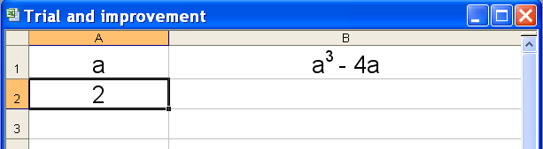
Using a spreadsheet
Solve a³ – 4a = 2.
We can use a spreadsheet to solve this equation by trial and improvement.
After heading the columns, put your first guess into cell A2.

Slide 9
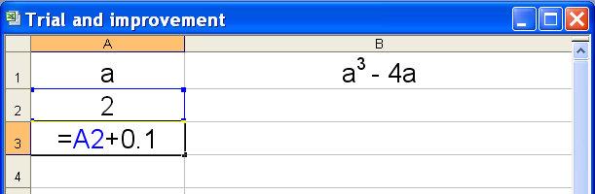
Using a spreadsheet
In cell A3 we can type =A2+0.1 without any spaces.
Clicking on the bottom right hand corner of this cell and dragging down to cell A12 will enter the numbers 2.1, 2.2, 2.3 … increasing in steps of 0.1 up to 3.

Slide 10
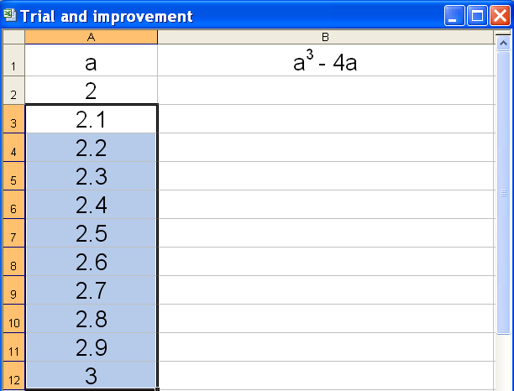
Using a spreadsheet

Slide 11
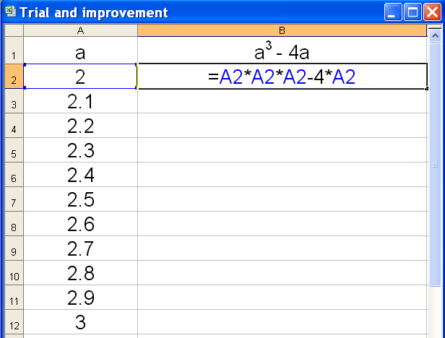
Using a spreadsheet
Notes:
Write this formula in cell B2 and ask pupils for explanation.

Slide 12
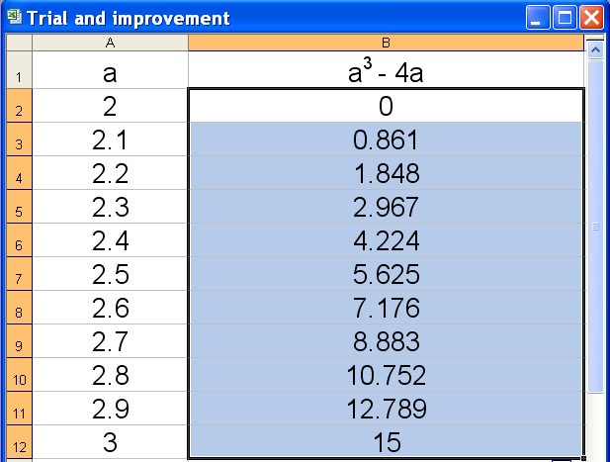
Using a spreadsheet
Notes:
Ask pupils to use the numbers in column B to find which two numbers the solution lies between.

Slide 13
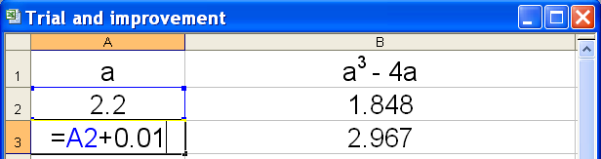
Using a spreadsheet
We can see that the solution lies between 2.2 and 2.3.
We can now change the value in cell A2 to 2.2.
In cell A3 we can then enter =A2+0.01 without any spaces.
Clicking on the bottom right hand corner of this cell and dragging down to cell A12 will enter the numbers 2.21, 2.22, 2.23 … increasing in steps of 0.01 up to 2.3.

Slide 14
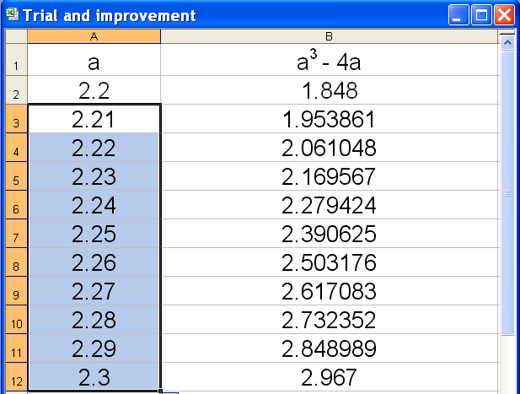
Using a spreadsheet
Notes:
Again, ask pupils to use the numbers in column B to find which two numbers the solution lies between.

Slide 15
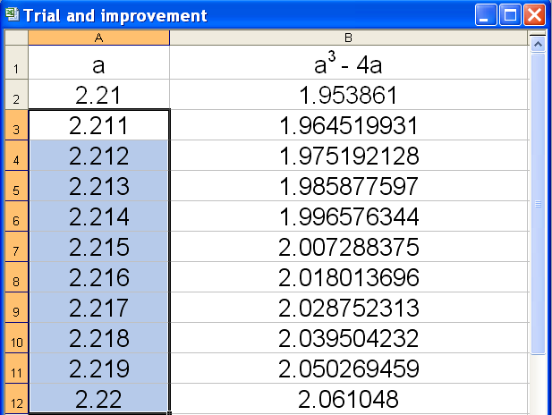
Using a spreadsheet
Notes:
Explain that we need to change the value in cell A2 to 2.1 and write =A2+0.001 in cell A3.
The pupils should place the solution between 2.214 and 2.215 and choose 2.214 because it gives the result closer to 2 than 2.215.

Slide 16
Solving non-linear equations
Using the results from the spreadsheet we can see that for
a³ – 4a = 2
a = 2.214 (to 3 d.p.)
Could this equation have any more solutions?
Use the spreadsheet to look at values of a³ – 4a between –2 and 0. Increase the values of a by 0.1.
Find every solution to the equation a³ – 4a = 2.

Slide 17
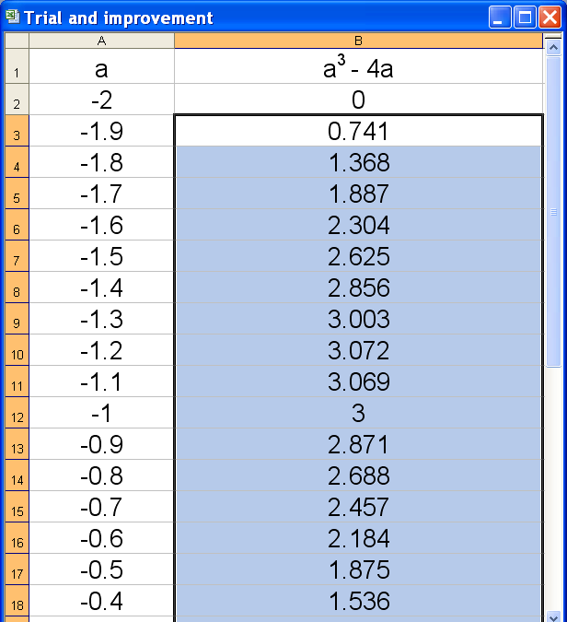
Using a spreadsheet
There are two more solutions to a³ – 4a = 2 between –1.7 and –1.6 …
… and between –0.6 and –0.5.

